Slide 1

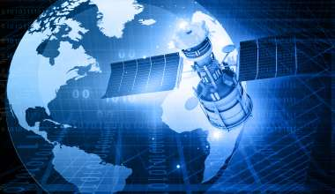

Application of Big Data in GPS Navigation Systems
Use these slides as a starting point for customizing your presentation.
Open the Plus add-on for more options.
Plus tip:
By : Asmit Dixit
CSE (7th Sem)
BIET , Jhansi

Slide 2
Key Points
Introduction to Big Data
How GPS Systems Work
Insights and Data about GPS Industry
Synergy between Big Data and GPS system
Enhanced Accuracy by Data Analytics
Role of Big data in GPS navigation
Role of Big data in Real-Time traffic monitoring
Continuous Mapping Updates
Case Studies: GPS Success with Big Data
Future trends
Hurdles in implementation
Solutions
Benefits of Big data-driven GPS
Conclusion

Slide 3
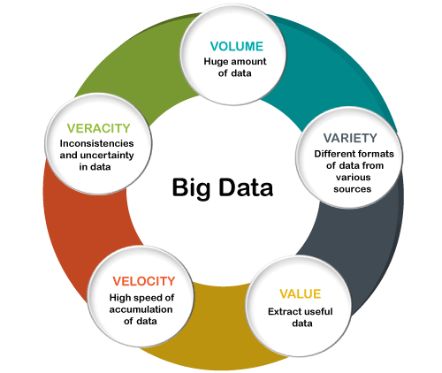
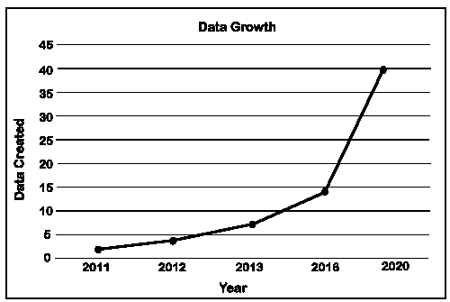
Introduction to Big Data
Big Data refers to large and complex datasets that cannot be easily managed, processed, and analyzed using traditional methods.
It encompasses a wide variety of data types, from structured to unstructured. It can be categorized by five Vs: Volume , Velocity , Variety,Value and Veracity
By analyzing massive amounts of data from various sources, such as GPS devices, traffic sensors, and historical patterns, GPS navigation systems can enhance the user experience and enable efficient and reliable navigation

Slide 4
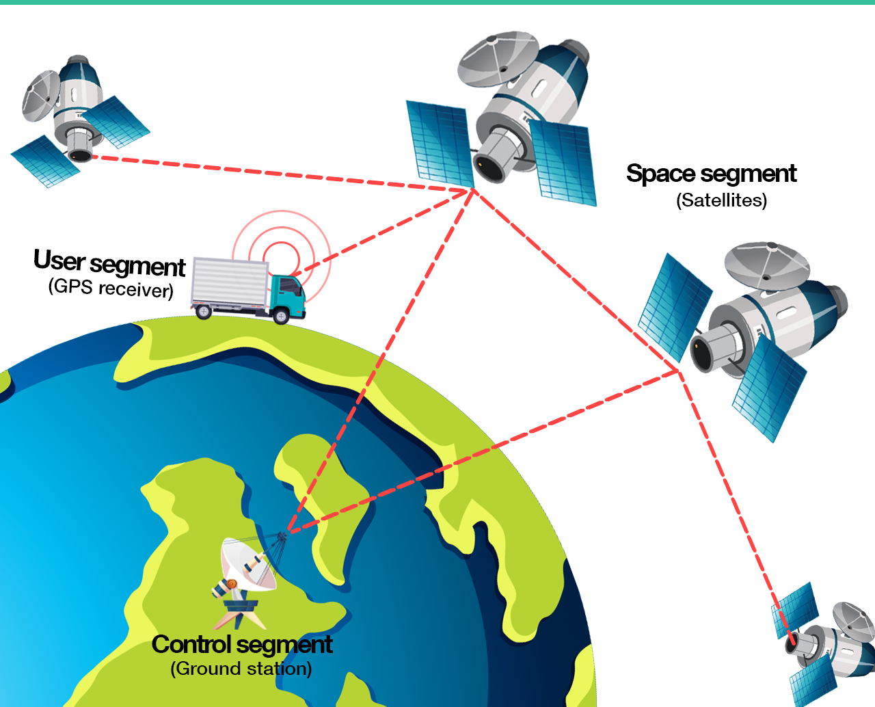
How GPS Systems Work
OverView of GPS Technology
Satellite Constellation
Satellite Signals
Receiver and Trilateration
Time Difference Measurement
Satellite Position Calculation
Error Correction
Displaying Location

Slide 5
1. Satellite Constellation: The GPS system consists of a constellation of at least 24 satellites orbiting the Earth.
2. Satellite Signals: Each GPS satellite broadcasts a continuous signal that contains information about its
position and a precise timestamp.
3. Receiver and Trilateration: A GPS receiver on the ground or in a device (like a smartphone) receives signals
from multiple satellites. At least four satellites are needed for accurate 3D
positioning (latitude, longitude, and altitude).
4. Time Difference Measurement: The GPS receiver calculates the time it took for each signal to reach it from the
respective satellites. This time difference is crucial for determining the
receiver's distance from each satellite.
5. Satellite Position Calculation: Using the time information and the known positions of the satellites, the GPS
receiver can calculate its distance from each satellite. This is done using a
method called trilateration.
6. Trilateration: Trilateration is a process that involves determining a location based on its distance from three
known points. In GPS, it's a bit more complex because it's done in three dimensions.
7. Calculating Position :By trilaterating the distances from at least four satellites, the GPS receiver can calculate its precise position in 3D space.

Slide 6
Insights and Data about GPS Industry
$37.4 billion
$100 billion
95-98%
Market value
In 2022
Expected to be before 2028
Real-time Traffic Updates

Slide 7
Synergy between Big data and GPS system
Enhanced Accuracy :
Real time Monitoring :
Data Correction
Augmentation Systems
Multi-Constellation Integration
Data Aggregation
Dynamic Routing
Predictive Analysis

Slide 8
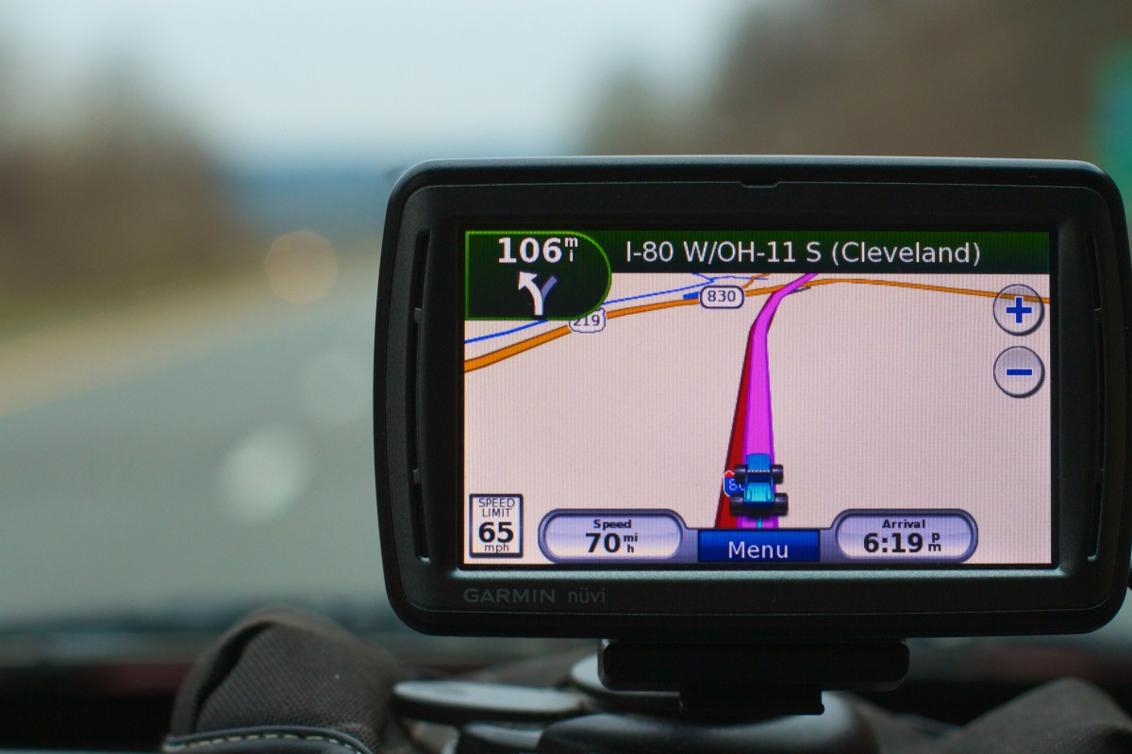
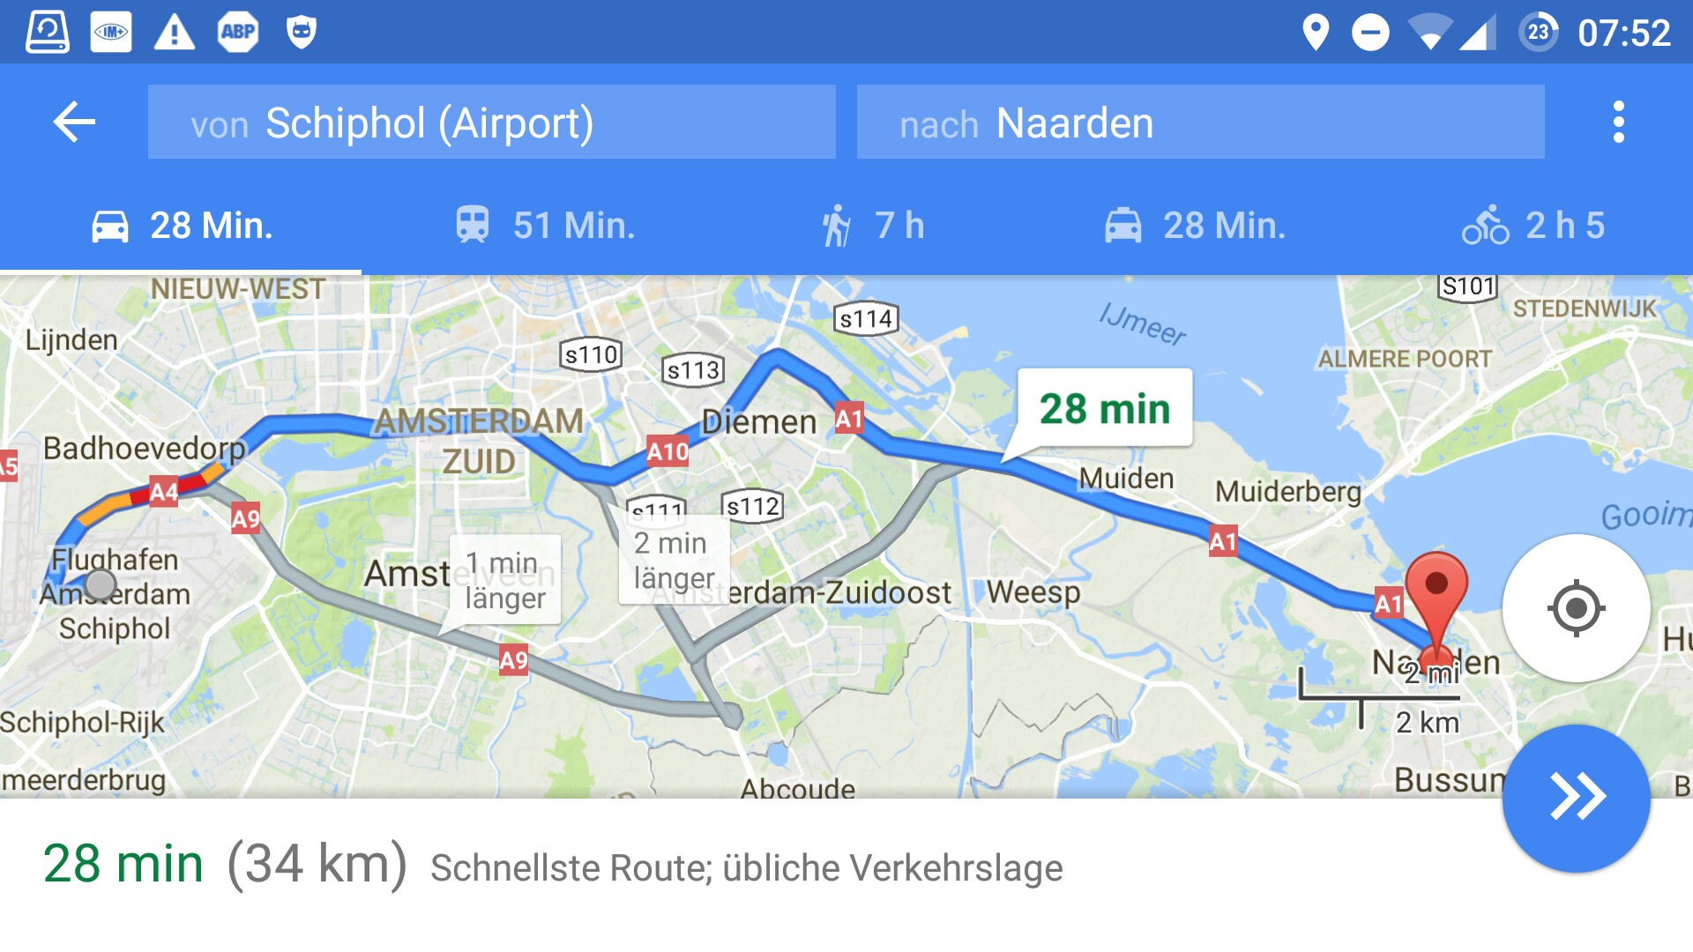
Enhanced Accuracy By DA
Atmosphere Interference Correction :
Data Collection and Analysis
Modeling and Prediction
Clock Synchronization :
Monitoring and Comparison
Statistical Analysis

Slide 9
Role of Big Data in GPS Navigation
Real-time Traffic Updates
Big data allows GPS systems to provide real-time traffic updates by analyzing data from various sources. This enables drivers to avoid congestion.
Optimized Routing
Big data enables GPS systems to optimize routes based on real-time traffic conditions and road closures. The system calculates the most efficient route. It analyze traffic patterns , congested areas and suggest alternative routes to avoid delays
Personalized Recommendations
Big data allows GPS systems to provide personalized recommendations by collecting information about user preferences , behavior and historical routes. For instance,GPS application can suggest preferred routes and anticipate destination based on past habits.

Slide 10
Role of Big data in Real Time traffic Monitoring
Data Aggregation and processing
Identifying Congestion
Big data analytics collects vast amounts of information from various sources like traffic sensors , GPS devices and cameras.
Pattern Recognition
Historical Data Comparison
Anomaly Detection
Integration with Emergency Services
Dynamic data uploading
Optimal Route Suggestion
Big data enables continuous updates of traffic information and processes incoming data in real-time, allowing GPS navigation system to provide user with current and accurate traffic condition
Real Time Route Optimization
AI- Driven Decision Making

Slide 11
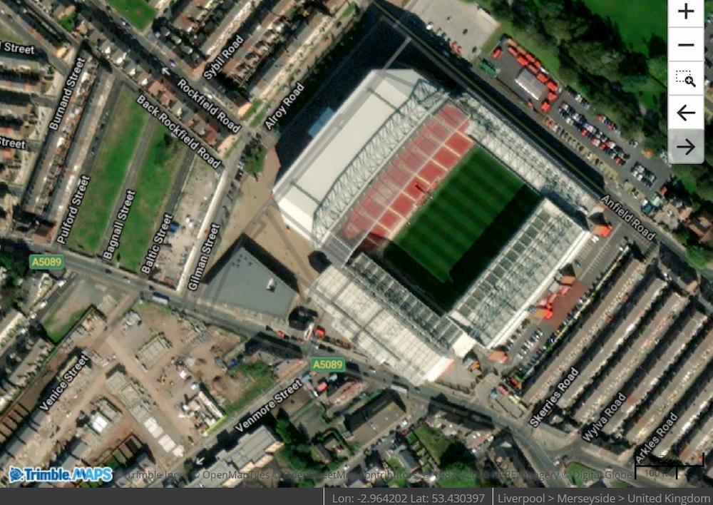
Continuous Mapping Updates
Crowd-sourcing for Map updates :
User-Generated Data
Feedback and Correction
Community -Driven Updates
Data Sharing Mechanisms :
Partnerships with Gov. Agencies
Integration with Local Businesses and Services
API’s for Third Party Developers

Slide 12
Case Studies :
Google Maps : Google Maps is one of the most widely used navigation application globally . It extensively uses BIG DATA to provide accurate and up-to-date mapping information .
2. Waze : It’s a community-driven navigation app that provides real-time traffic and road information by heavily relies on BIG DATA to offer the dynamic updates of accidents ,road conditions and police presence.
3. Uber : Uber is a ride-hailing service that uses GPS navigation to connect drivers and riders.
Uber employs BIG DATA for driver Efficiency and surge pricing and demand forecasting.
4. Here : Here technologies provides mapping and location based services for businesses and individuals. It uses Big Data to create highly accurate maps for AUTONOMOUS VEHICLES
Including real-time information about lane , traffic signals and more for safe and efficient automatic driving.

Slide 13

Future trends of Big data and GPS integration
5G Technology
Internet of Things
Artificial Intelligence and Machine Learning
Augmented Reality
BlockChain for secure location Data

Slide 14
Hurdles with Big Data Implementation in GPS
Privacy Concerns : Collecting and processing large volumes of location data can raise privacy concerns, as users may be apprehensive about sharing their precise whereabouts.
Data Security :Storing and managing vast amounts of sensitive location data requires robust security measures to prevent unauthorized access or data breaches.
Data Quality and Accuracy: Ensuring the quality and accuracy of the data collected is crucial for reliable GPS navigation.
Scaling Infrastructure:Processing and storing large volumes of data requires a robust and scalable infrastructure.
Ethical Use of data :Ensuring that data is used ethically and for legitimate purposes is critical to building trust with users.

Slide 15
Strategies to Mitigate the Challenges
For Privacy issues :
Transparency and Consent
Anonymization and Aggregation
For Data accuracy :
Crowd-sourced Data Validation
Feedback Loops
For data Security :
Encryption
Access Control
For Scaling Infrastructure :
Cloud based Solution
Distributed System
.

Slide 16

Benefits of Big Data - driven GPS
Transportation
Retail & Ecommerce
Healthcare and Emergency
Agriculture
Route Optimization
Real-Time Tracking
Predictive Maintenance
Location-based marketing
Inventory Management
Customer Insights
Patient Transportation
Emergency Response
Telemedicine and Remote Monitoring
Precision Farming
Soil Analysis
Crop Monitoring

Slide 17

Conclusion
Integration of Big Data in GPS navigation is a game-changer by enhancing accuracy, speed, and personalization, revolutionizing how we navigate our world.
Through real-time traffic monitoring, continuous mapping updates, and advanced analytics, GPS systems offer dynamic, customized experiences.
Challenges like privacy and data security must be addressed.
With emerging technologies like 5G, IoT, and AI, the future holds even greater promise

Slide 18


